Slide 1

Stars and Mars

Slide 2
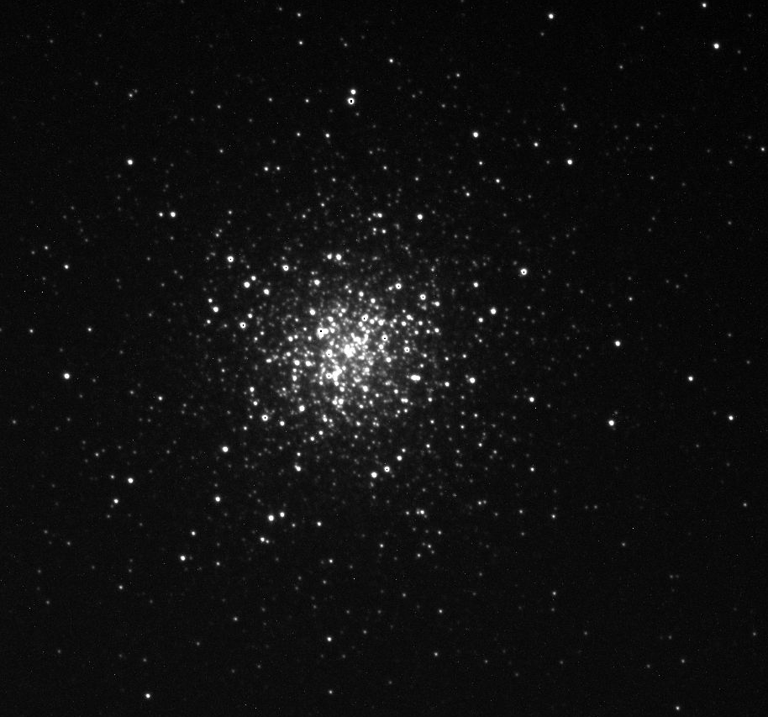
M3 Through the Telescope
M3 is 33,900 light years away from us.

Slide 3
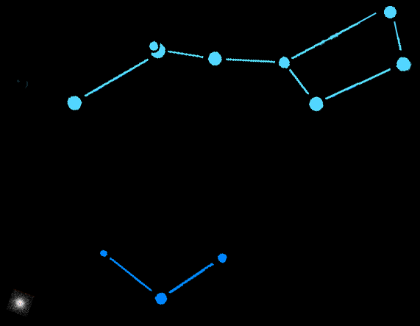
M3
M3 In the Night Sky
M3 is in the constellation Canes Venatici (the hunting dogs) just below the handle of the Big Dipper.

Slide 4
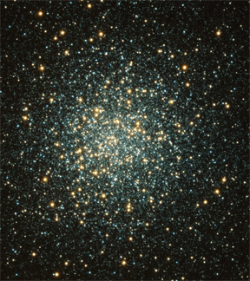
What is M3?
M3 is a globular cluster of stars that is over 160 light years across and contains about 500,000 stars.

Slide 5
Detailed Image of M3
Of the 200 or so globular clusters in our Milky Way galaxy, M3 is one of the largest and brightest. It is easily visible in the Northern hemisphere with a good pair of binoculars.

Slide 6
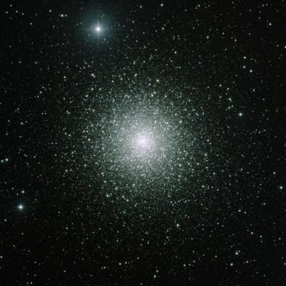
What is a Globular Cluster?
A globular cluster is a tightly packed group of about 100,000 or more stars. There are about 150-200 globular clusters in the Milky Way Galaxy.

Slide 7
How Old Are Globular Cluster?
The globular clusters of our galaxy are very old - the same age as the galaxy itself, about 12 billion years old.

Slide 8
How Big are Globular Clusters?
160 light years
At the speed of light (186,000 mi/sec) it takes 160 years for light to cross M3 from one side to the other. – That’s 2 lifetimes!

Slide 9
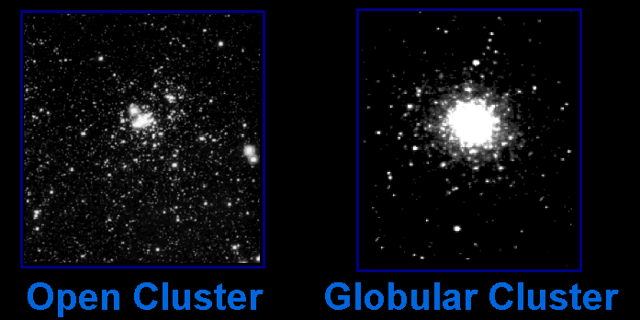
Types of Star Clusters
There are two main types of star clusters in our galaxy …

Slide 10
Star Clusters
Types of Star Clusters
Open clusters orbit within the disc of the galaxy. Globular clusters orbit above and below the plane of the galaxy.

Slide 11
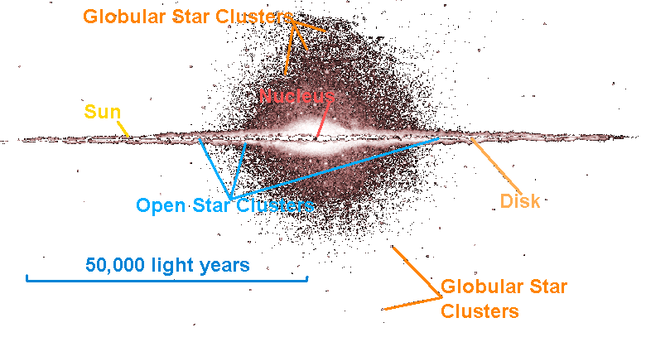
Our Milky Way Galaxy
(side view)

Slide 12
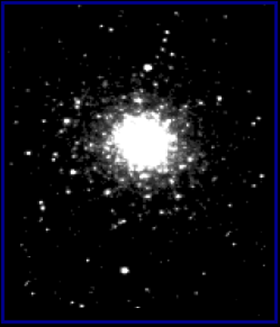

Open and Globular Star Clusters Are Different Sizes
Open Clusters
Globular Clusters
are about 30 light years across.
are about 150 light years across.
Open clusters are 5 times smaller than globular clusters. They only look the same size because they are closer.

Slide 13
Open and Globular Clusters Have Different Numbers of Stars
Open Clusters
Globular Clusters
have hundreds to thousands of stars.
have thousands to nearly a million stars.

Slide 14
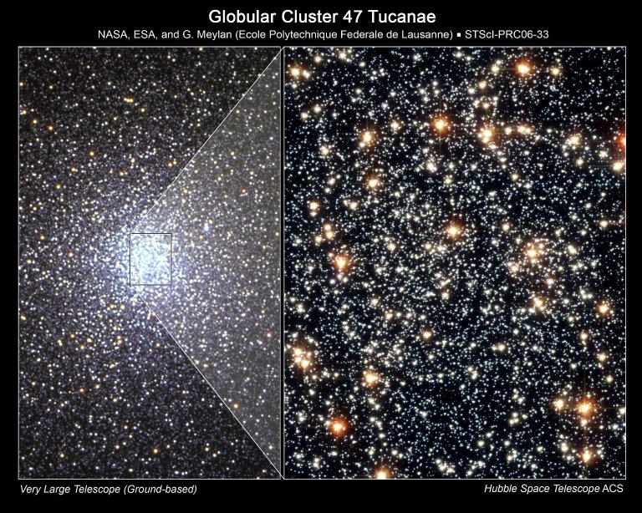
Closely Packed Stars
Observations by the Hubble Space Telescope suggest that stars within globular clusters are so densely packed at their cores that they literally brush past each other.

Slide 15
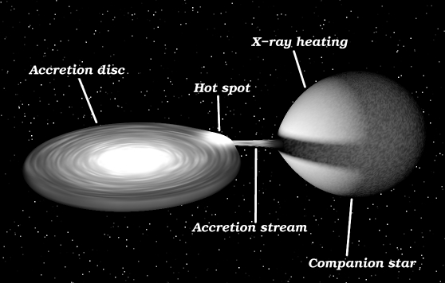

X-Ray Binaries
The Chandra X-ray Observatory has confirmed that close encounters between densely-packed stars can form a unique type of double-star called and x-ray binary.
Chandra X-ray Telescope

Slide 16
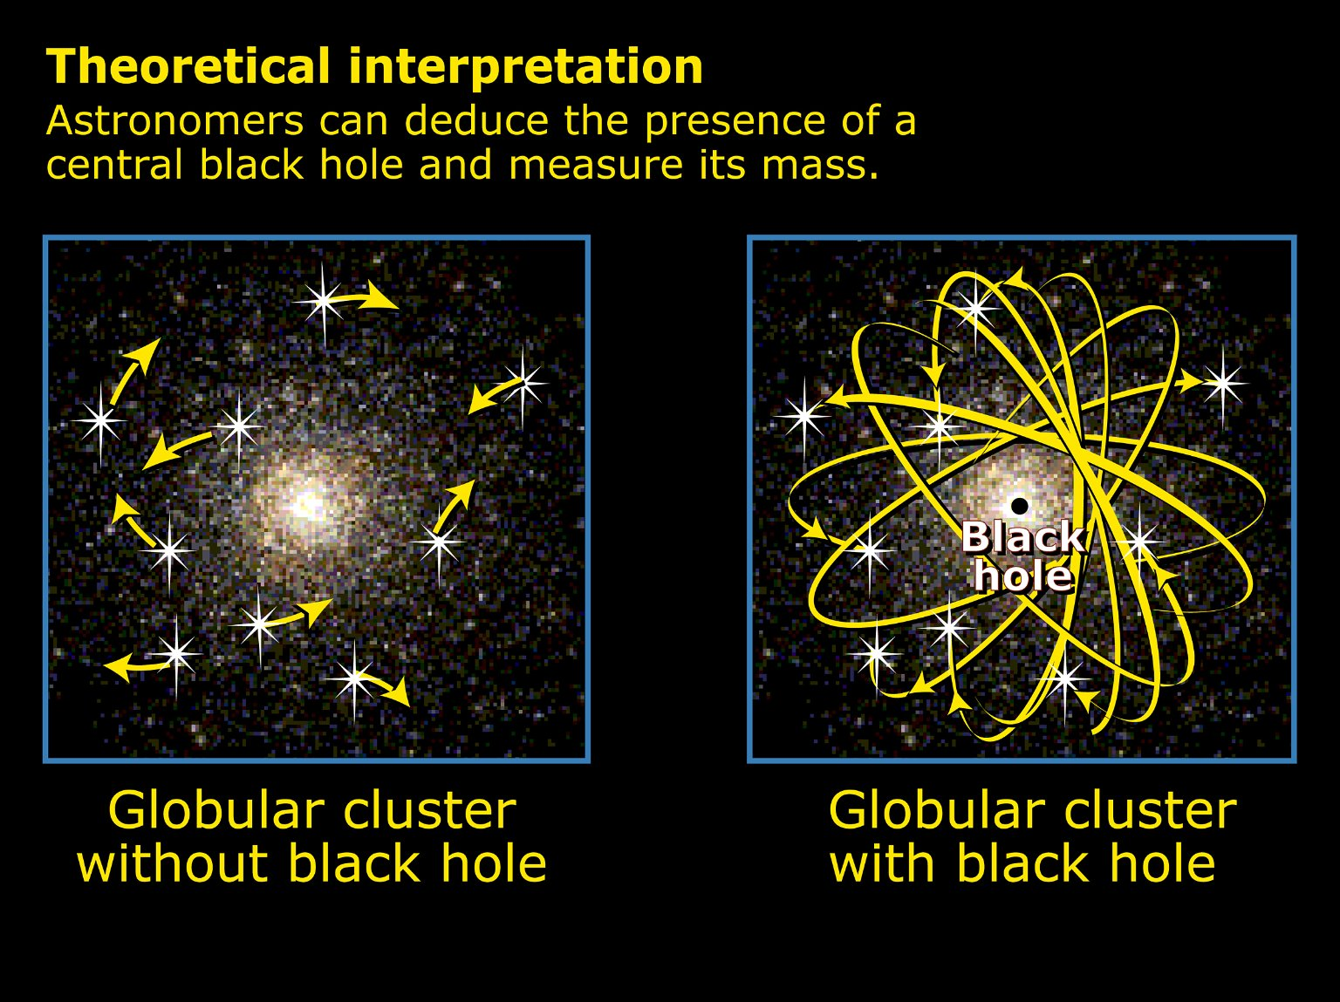

Black Holes
Hubble Space Telescope
The Hubble Space Telescope has also shown us that the density of stars in some globular clusters as you approach their core is so great that medium sized (1,000 solar mass) black holes may exist at their centers.

Slide 17
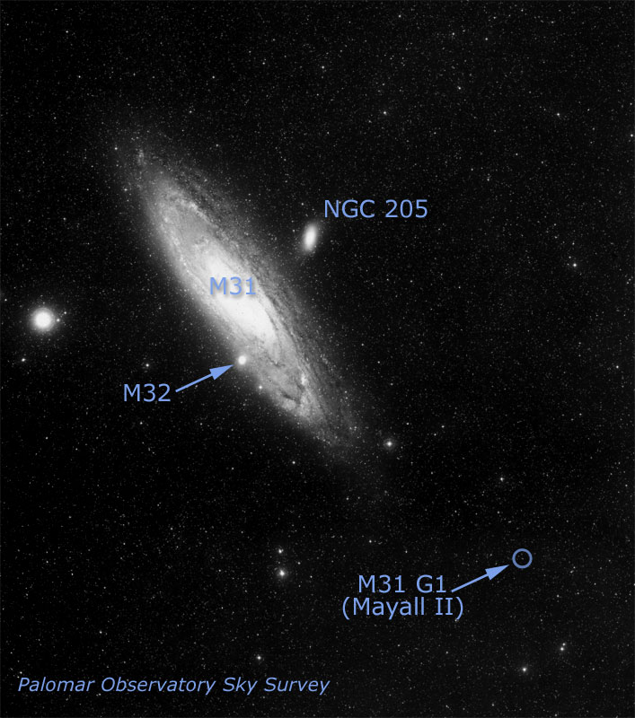
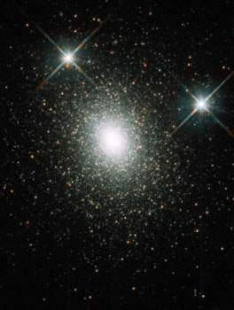
Other Galaxies Have Halos of Globular Clusters
HST image of G1
This globular cluster called G1 is in the halo of the Andromeda galaxy (M31).
This cluster has a medium-sized black hole in it!

